Slide 1

PRESENTATION
DATA ANALYTICS PROJECT
BY: SHREYA, IIITDM KANCHEEPURAM
TOOLS USED: PANDAS, MATPLOTLIB, SEABORN, SCIKIT-LEARN, PYTHON
13 JULY, 2025

Slide 2

CHALLENGE BACKGROUND
MESS ATTENDANCE IS HIGHLY IRREGULAR WEEK-TO-WEEK.
RESULTS IN EITHER OVERCROWDING OR WASTAGE.
OBJECTIVE: USE HISTORICAL MESS DATA TO ANALYZE CROWD BEHAVIOR AND PREDICT FUTURE USAGE.
DELIVER ACTIONABLE INSIGHTS TO OPTIMIZE FOOD PLANNING.

Slide 3

UNDERSTANDING THE DATASET
COLUMN
DESCRIPTION
MESS HALL IDENTIFIER
MESS_ID
START OF THE WEEK
DATE
NUMBER OF MEALS SERVED
WEEKLY_CROWD
1 = HOLIDAY WEEK
IS_HOLIDAY
AVERAGE WEEKLY TEMP
TEMPERATURE
MENU_SCORE
QUALITY OF FOOD THAT WEEK
CAMPUS EVENTS INTENSITY
EVENT_INTENSITY_INDEX
ACADEMIC PRESSURE LEVEL
STRESS_LEVEL

Slide 4


CLEANING AND PREPARING THE DATA
Role of pandas: Used for data loading, transformation, and preparation of model features.
Stripped extra spaces from column names using:
df.columns = df.columns.str.strip()
Converted Date to datetime using:
df['Date'] = pd.to_datetime(df['Date'], format='mixed', dayfirst=True)
Checked .info(), .describe() — no nulls or duplicates
6435 rows of valid weekly data

Slide 5

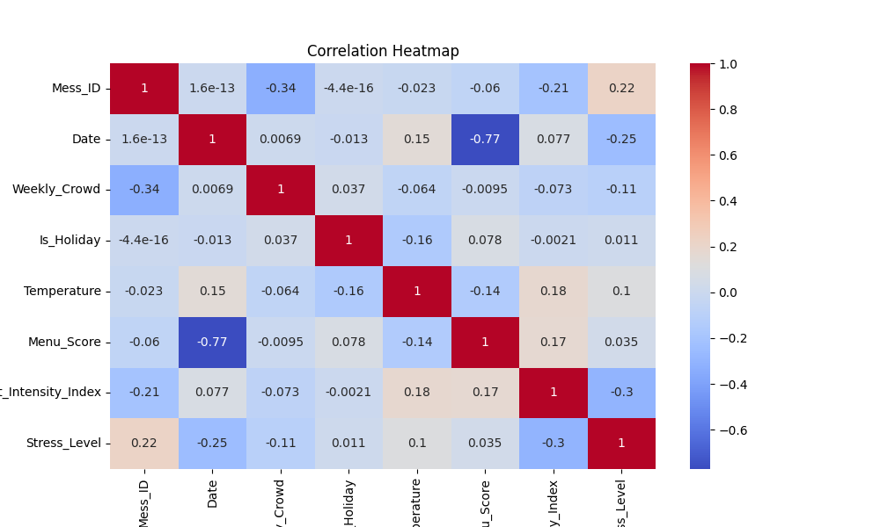
EXPLORING PATTERNS & VISUAL INSIGHTS
-Descriptive Statistics showed normal distributions
-Used df.describe() to summarize each feature
-Created visualizations using seaborn and matplotlib
Correlation Heatmap
Helps quickly identify which variables are most connected
Used sns.heatmap(df.corr(), annot=True)

Slide 6
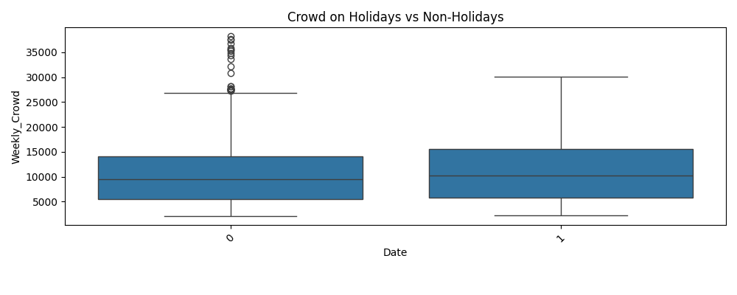
EXPLORING PATTERNS & VISUAL INSIGHTS
Holiday Boxplot
Used sns.boxplot(x='Is_Holiday', y='Weekly_Crowd', data=df)
Shows that holidays have more crowd outliers, indicating special spikes in attendance

Slide 7
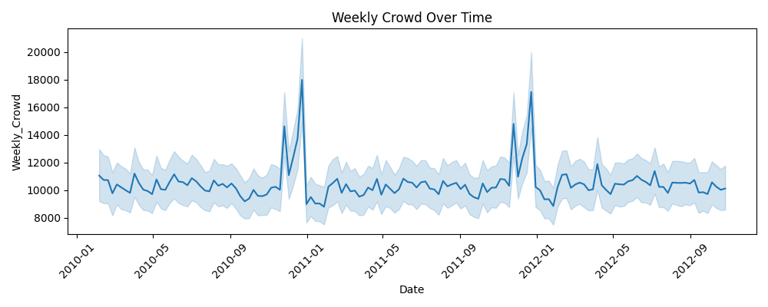
EXPLORING PATTERNS & VISUAL INSIGHTS
Line Plot – Date vs Weekly Crowd
Used sns.lineplot(x='Date', y='Weekly_Crowd', data=df)
Helped identify cyclical patterns across years — like lower mess usage during exam months
Graphs saved using plt.savefig() in /graphs folder

Slide 8


Used: Linear Regression from scikit-learn
model = LinearRegression()
model.fit(X_train, y_train)
BUILDING THE PREDICTION MODEL
Input Features: Is_Holiday, Temperature, Menu_Score, Event_Intensity_Index, Stress_Level
Target Output: Weekly_Crowd
Mean Squared Error: ~31.6 million
Coefficients:
Holiday: +856 | Menu Score: +200
Stress: –438 | Events: –494 | Temp: –5

Slide 9

FINAL INSIGHTS:
Better Menu Score = more crowd (+200 per point)
Holiday Weeks = +856 crowd on average
Stress Level ↑ = crowd ↓ (–438 per point)
Temperature & Events: weak or mixed impact
Crowd is cyclic and influenced by semester pattern

Slide 10
FINAL RECOMMENDATIONS
Use prediction model weekly to guide food prep
Plan for extra crowd on holidays
Reduce prep during exam or high-stress weeks
Consider improving menu to attract more usage

Slide 11

HOW THE CODE WORKS (STEP-BY-STEP)
Import Libraries
pandas, seaborn, matplotlib, scikit-learn
Load & Clean Data
read_csv, fix column names, parse dates
EDA & Visuals
describe, heatmap, boxplot, lineplot
Select Features
Chose 5 relevant variables
Modeling
Train-test split → linear regression → MSE
Interpret Results
Analyzed model coefficients
Save Outputs
All visuals saved using plt.savefig()

Slide 12


TECHNICAL STACK & IMPLEMENTATION
pandas: data handling & transformation
matplotlib + seaborn: graphing & pattern discovery
scikit-learn: regression modeling
Code: modular, commented, well-structured
All graph files are saved for reporting use
mess-crowd-analysis/
├── dataset.csv → Input data
├── mess_analysis.py → Main script
├── graphs/ → Visual outputs
│ ├── correlation_heatmap.png
│ ├── holiday_vs_crowd.png
│ └── crowd_over_time.png
├──Report/
| ├── report.pptx → Final report
├──video explanation

Slide 13

THANK YOU
FOR YOUR ATTENTION

